Slide 1
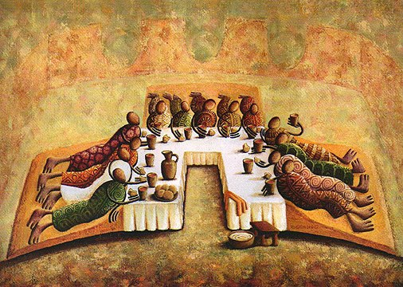
John 13.18-35
Painting by Okaybabs, from his Facebook page

Slide 2
John 13.18 NET: “What I am saying does not refer to all of you. I know the ones I have chosen. But this is to fulfill the scripture, ‘The one who eats my bread has turned against me.’”
Psalm 41.9

Slide 3
John 13.18-19: “What I am saying does not refer to all of you. I know the ones I have chosen. But this is to fulfill the scripture, ‘The one who eats my bread has turned against me.’ [Psalm 41.9]
I am telling you this now, before it happens, so that when it happens you may believe that I am he.”
you may believe that I AM

Slide 4
John 13.20: “I tell you the solemn truth, whoever accepts the one I send
accepts me, and whoever accepts
me accepts the one who sent me.”
ἀμὴν ἀμὴν = truly truly
λαμβάνω = “I take” or “I receive”
here in the sense of
recognizing authority

Slide 5
John 13.21-24: When he had said these things, Jesus was greatly distressed in spirit, and testified, “I tell you the solemn truth, one of you will betray me.” The disciples began to look at one another, worried and perplexed to know which of them he was talking about. One of his disciples, the one Jesus loved, was at the table to the right of Jesus in a place of honor. So Simon Peter gestured to this disciple to ask Jesus who it was he was referring to.

Slide 6
John 13.21-24: When he had said these things, Jesus was greatly distressed in spirit, and testified, “I tell you the solemn truth, one of you will betray me.” The disciples began to look at one another, worried and perplexed to know which of them he was talking about. One of his disciples, the one Jesus loved, was at the table to the right of Jesus in a place of honor. So Simon Peter gestured to this disciple to ask Jesus who it was he was referring to.

Slide 7
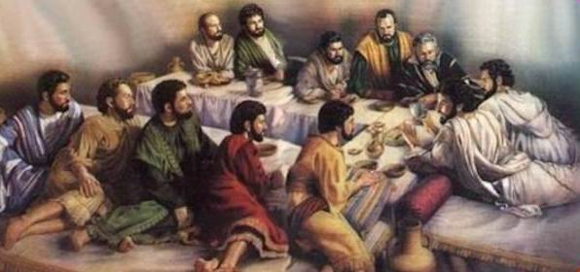
One of his disciples, the one Jesus loved, was at the table to the right of Jesus in a place of honor.
So Simon Peter gestured to this disciple
to ask Jesus who it was he was referring to.
“was reclining on Jesus’ chest”
photo taken from beit-el.blogspot.com

Slide 8
John 13.25-26: Then the disciple whom Jesus loved leaned back against Jesus' chest and asked him, “Lord, who is it?” Jesus replied, “It is the one to whom I will give this piece of bread after I have dipped it in the dish." Then he dipped the piece of bread in the dish and gave it to Judas Iscariot, Simon's son.

Slide 9
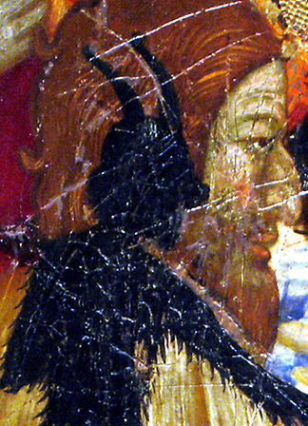
John 13.27-29: And after Judas took the piece of bread, Satan entered into him. Jesus said to him, “What you are about to do, do quickly.” (Now none of those present at the table understood why Jesus said this to Judas. Some thought that, because Judas had the money box, Jesus was telling him to buy whatever they needed for the feast, or to give something to the poor.)
image from Dick Lanham’s Twitter

Slide 10
John 13.30-33: Judas took the piece of bread and went out immediately. (Now it was night.) When Judas had gone out, Jesus said, “Now the Son of Man is glorified, and God is glorified in him. If God is glorified in him, God will also glorify him in himself, and he will glorify him right away. Children, I am still with you for a little while. You will look for me, and just as I said to the Jewish religious leaders, 'Where I am going you cannot come,' now I tell you the same.”

Slide 11
John 13.30-33: Judas took the piece of bread and went out immediately. (Now it was night.) When Judas had gone out, Jesus said, “Now the Son of Man is glorified, and God is glorified in him. If God is glorified in him, God will also glorify him in himself, and he will glorify him right away. Children, I am still with you for a little while. You will look for me, and just as I said to the Jewish religious leaders, 'Where I am going you cannot come,' now I tell you the same.”

Slide 12
John 13.34-35: “I give you a new commandment– to love one another. Just as I have loved you, you also are to love one another. Everyone will know by this that you are my disciples– if you have love for one another.”
Leviticus 19.18 NET: “…you must love your neighbor
as yourself. I am the LORD.”
Matthew 22.39 NET: “Love your neighbor as
yourself.”

Slide 13
John 13.34-35: “I give you a new commandment– to love one another. Just as I have loved you, you also are to love one another. Everyone will know by this that you are my disciples– if you have love for one another.”
“I am giving you a [new commandment],
[that you should love one another],
[that just as I have loved you,
      you also should love one another].”

Slide 14
John 13.34-35: “I give you a new commandment– to love one another. Just as I have loved you, you also are to love one another. Everyone will know by this that you are my disciples– if you have love for one another.”

